Slide 1

SYSTEM OF LINEAR EQUATIONS AND MATRICES
Vector Calculus and Linear Algebra

Slide 2
Matrix :
◆ A rectangular array (arrangement) of mn numbers (real or complex) in m rows and n columns is called a matrix of order m by n written as m×n.
◆ A m×n matrix is usually written as
^{𝑎}1𝑛
^{𝑎}2𝑛
^{𝑎}3𝑛
⋮
^{𝑎𝑚𝑛} 𝑚×𝑛
◆ This matrix is denoted in a simple form as
^{𝑎}11 | ^{𝑎}12 | ^{𝑎}13 ⋯
^{𝑎}21 | ^{𝑎}22 | ^{𝑎}23 ⋯
^{𝑎}31 | ^{𝑎}32 | ^{𝑎}33 ⋯
⋮ ^{𝑎}𝑚1 | ⋮ ^{𝑎}𝑚2 | ⋮ ^{𝑎}𝑚3 | ⋯
𝐴 =
^{𝑎}𝑖𝑗
𝑚×𝑛
Where 𝑎_{𝑖𝑗} is the element in the 𝑖^{𝑡ℎ} row and 𝑗^{𝑡ℎ} column

Slide 3
Type Of Matrices :
1. Row Matrix :
A matrix which has only one row is called a row matrix or
row vector. i.e.
1 −1 2
2
3 1×4 5 1×2
2. Column Matrix :
A matrix which has only one column is called a column matrix or column vector.
i.e.
−1
1
0
4
1
2
3 3×1
4×1

Slide 4
3. Square Matrix :
A matrix in which the number of rows is equal to the number of columns is called a square matrix. i.e.
1 −1 2
3 1 4
5 0
1 2
−1 4 _{2×2}
6 3×3
4. Null or Zero Matrix :
A matrix in which each element is equal to zero is called a null matrix and is denoted by O.
i.e.
0 0
0 0
0 | 0 | 0
0 | 0 | 0
0 | 0 | 0

Slide 5
5. Diagonal Matrix :
A square matrix is called a diagonal matrix if all its non diagonal elements are zero.
i.e.
1 0 0
0 2 0
0 0 4
3 0
0 5
6. Scalar Matrix :
A diagonal matrix whose all diagonal elements are equal is called a scalar matrix.
i.e.
5 0
0 5
3 | 0 | 0
0 | 3 | 0
0 | 0 | 3

Slide 6
Identity or Unit Matrix :
A diagonal matrix whose all diagonal elements are unity (1) is called a unit or identity matrix and is denoted by I.
i.e.
1 0
0 1
Upper Triangular Matrix :
A square matrix in which all the entries below the diagonal are zero is called an upper triangular matrix. i.e.
1 3
0 2
1 | 0 | 0
0 | 1 | 0
0 | 0 | 1
4 | −3 | 2
0 | 3 | 5
0 | 0 | 1

Slide 7
10. Trace of a Square Matrix :
The sum of all the diagonal elements of a square matrix is called the trace
of a matrix. i.e.
−1 2 7 0
3 5 −8 4
1 2 7 −3
4 −2 1 0
If A =
then
Trace (MODE) of
𝐴 = −1 + 5 + 7 + 0 = 11
◆ Note : If 𝐴 =
^{𝑎}𝑖𝑗
then
𝑛×𝑛
Trace of 𝐴 = 𝑎₁₁ + 𝑎₂₂ + 𝑎₃₃ + ------ +𝑎_{𝑚𝑛}
𝑛
= 𝑎_{𝑖𝑖}
𝑖=1

Slide 8
11. Transpose of a Matrix :
The matrix obtained by interchanging the rows and columns of a given matrix A is called the transpose of A and is denoted by 𝐴^{𝑇} or 𝐴′.
i.e.
1 4
2 5
3
1 2 3
4 5 6
𝑇
𝐼𝐹 𝐴 =
𝑡ℎ𝑒𝑛 𝐴 =
2×3
6 3×2
Properties :
_{𝐴}𝑇
II. 𝐴𝐵
^{𝑇} = 𝐴
𝑇 _{= 𝐵}𝑇_{𝐴}𝑇
I.
𝐴 + 𝐵 ^{𝑇} = 𝐴^{𝑇} + 𝐵^{𝑇}
IV. 𝐾𝐴 ^{𝑇} = 𝐾𝐴^{𝑇} where K is any scalar.
III.

Slide 9
12. Determinant of a Matrix :
If A is a square matrix then determinant of A is represented as det(A).
i.e.
𝐴 or
2 1 −3
4 3 5
5 4 9
2 1 −3
4 3 5
5 4 9
𝐼𝐹 𝐴 =
𝑡ℎ𝑒𝑛 det 𝐴 =
13. Singular and Non-singular Matrix :
A square matrix A is called singular if det(A)=0 and non-singular or
invertible if det(A)≠0.
i.e.
2 1 −3
𝐿𝑒𝑡 𝐴 = 4 3 5
5 4 9
2 1 −3
𝑡ℎ𝑒𝑛 det 𝐴 = 4 3 5
5 4 9
⟹ 𝐴 = 2 27 − 20 − 1 36 − 25
= 14 − 11 − 3 = 0
Hence, A is a singular matrix.
− 3(16 − 15)

Slide 10
Elementary Transformations :
Elementary Row Transformations :
1) 𝑅_{𝑖𝑗}
2) 𝐾𝑅_{𝑖}
∶ Interchange of 𝑖^{𝑡ℎ} and 𝑗^{𝑡ℎ} row.
∶ Multiplication of 𝑖^{𝑡ℎ} rowby K.
3) 𝑅_{𝑗} + 𝐾𝑅_{𝑖} ∶ Addition of K times the 𝑖^{𝑡ℎ} row to the 𝑗^{𝑡ℎ}
row.
Elementary column Transformations :
1) 𝐶_{𝑖𝑗}
2) 𝐾𝐶_{𝑖}
∶ Interchange of 𝑖^{𝑡ℎ} and 𝑗^{𝑡ℎ} column.
∶ Multiplication of 𝑖^{𝑡ℎ} column by K.
3) 𝐶_{𝑗} + 𝐾𝐶_{𝑖} ∶ Addition of K times the 𝑖^{𝑡ℎ} column to the
𝑗^{𝑡ℎ} column.

Slide 11
◆ Equivalent Matrices :
Two matrices A and B of same order are said to be equivalent matrices if one of them is obtained from the other by elementary transformation.
Symbolically, we can write A ~ B.
◆ Row Echelon form :
A given matrix is said to be in row echelon form if it
satisfies the following properties:
The zero rows of the matrix if they exists occur below the non-zero rows of the matrix.
The first non-zero element in any non-zero row of the matrix must be equal to unity (1). We call this
a leading 1.

Slide 12
III. In any two successive rows that do not consists entirely of zeros, the leading 1 in the lower row occurs farther to the right than the leading 1 in the higher row.
The following matrices are in row echelon form :
1 1 0
0 1
0 0 0
1 4 −3 7
0 1 6 2
0 0 1 5
0 1
0 0
0 0
2
1
0
6 0
−1 0
0 1
0 ,
,

Slide 13
◆ Reduced Row Echelon Form :
A given matric is said to be in reduced row echelon form if it satisfies the following properties :
A matrix is of necessity in row echelon form.
Each column that contains a leading 1 has zero everywhere else in that column.
The following matrices are in reduced row echelon
form.
0 1 −2 0 1
1 0 0 1 0 0 4
0 0
0 0
0 | 0 | 0 | 1 | 3
0 | 0 | 0 | 0 | 0
0 | 0 | 0 | 0 | 0
0 | 1 | 0 | 0 | 1 | 0 | 7
0 | 0 | 1 | 0 | 0 | 1 | −1

Slide 14
Notes:
Every matrix has an unique reduced row echelon form.
A row-echelon form of a given matrix is not unique. (Different sequences of row operations can produce different row-echelon forms.)

Slide 15
(reduced row - echelon form)
◆ Ex 4: (Row-echelon form or reduced row-echelon form)
2 −1 4⎤
(row - echelon form)
0 5⎤
⎡1
⎢0 1 |  | 0
⎣0 | 0 | 1
⎡0 1
⎢0 0 1 |  | 3
⎣0 0 0 0⎥
3⎥
⎥
⎢ − 2⎥⎦
⎢ ⎦
−1 3⎤
⎢0 0 1 3
⎡1 0
0 −1⎤
0 2⎥
⎡1 − 5 2
(reduced row - echelon form)
2⎥ (row - echelon
⎢0 1
⎢0 0 0 1
⎢0 0 1 3⎥
^{4⎥} form)
⎣⎢0 0
0
0⎦⎥
⎣⎢0 0 0
0
1⎦⎥
⎡1 2 − 3
4⎤
⎡1 2 −1 2⎤
⎢0 0 0 0⎥
⎢⎣0 1 2 − 4⎥⎦
⎢0 2 1 −1⎥
⎢⎣0 0 1
− 3⎥⎦

Slide 16
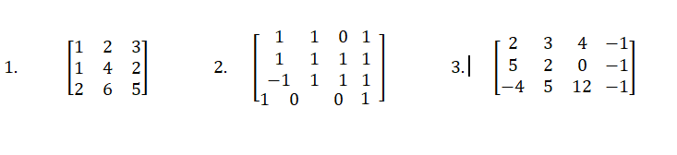
Find the echelon form and reduce row echelon form of the following matrix

Slide 17
System of Non-Homogeneous Linear Equations :
A system of m linear equations in n unknowns can be written as
𝑎₁₁𝑥₁ + 𝑎₁₂𝑥₂ + ⋯ ⋯ ⋯ + 𝑎_{1𝑛}𝑥_{𝑛}
𝑎₂₁𝑥₁ + 𝑎₂₂𝑥₂ + ⋯ ⋯ ⋯ + 𝑎_{2𝑛}𝑥_{𝑛}
= 𝑏₁
= 𝑏₂
= ⋮
⋮ ⋮ ⋮
𝑎_{𝑚1}𝑥₁ + 𝑎_{𝑚2}𝑥₂ + ⋯ ⋯ ⋯ + 𝑎_{𝑚𝑛}𝑥_{𝑛} = 𝑏_{𝑚}
The above system can be written in a matrix form as
^{𝑎}11 ^{𝑎}12
^{𝑎}21 ^{𝑎}22
⋮ ⋮
^{𝑎}𝑚1 ^{𝑎}𝑚2
⋯
⋯
^{𝑎}1𝑛
^{𝑎}2𝑛
⋮
^{𝑎}𝑚𝑛
𝑥₁
𝑥₂
⋮
𝑥_{𝑛}
𝑏₁
𝑏₂
⋮
𝑏_{𝑚}
=
⋯
Or Simply A
X = B where B ≠ 0

Slide 18
^{𝑎}11 ^{𝑎}12
^{𝑎}21 ^{𝑎}22
⋮ ⋮
^{𝑎}𝑚1 ^{𝑎}𝑚2
⋯
⋯
^{𝑎}1𝑛
^{𝑎}2𝑛
⋮
^{𝑎}𝑚𝑛
Where,
A =
⋯
is called coefficient matrix of order m×n.
𝑥₁
𝑥₂
⋮
𝑥_{𝑛}
𝑏₁
𝑏₂
⋮
𝑏_{𝑚}
𝑋 =
𝑎𝑛𝑑 𝐵 =
is any vector of order n × 1 & 𝑚 × 1
respectively.
^{𝑎}11 ^{𝑎}12 ⋯
^{𝑎}21 ^{𝑎}22 ⋯
⋮ ⋮
^{𝑎}𝑚1 ^{𝑎}𝑚2
𝑎_{1𝑛} : 𝑏₁
𝑎_{2𝑛} : 𝑏₂
⋮ ∶ ⋮
⋯ 𝑎_{𝑚𝑛} : 𝑏_{𝑚}
𝐴 : 𝐵
=
is the Augmented Matrix of the given system of linear equations.
NOTE: If AX= B and B=0,then system of equations is called homogeneous linear equation.

Slide 19
Solution of system of Linear Equations :
For a system of m linear equations in n unknowns, there are three
possibilities of the solutions to the system
[ If AX= B , where A is a square matrix
The system has unique solution , if ⏐A ⏐≠0
The system has infinite solutions , if ⏐A ⏐= 0
The solution has no solution , if ⏐A ⏐= 0
When the system of linear equations has one or more solutions, the system is said to be consistent otherwise it is inconsistent.

Slide 20
Gauss-Jordan Elimination :
Reducing the augmented matrix into reduced row echelon form or change the augmented matrix into the diagonal matrix or upper and lower triangular matrix is called Gauss-Jordan Elimination.
Gauss-Elimination :
Reducing the augmented matrix to “row echelon form” or upper triangular matrix and then stopping is called Gaussian Elimination.

Slide 21
1.2 Gaussian Elimination and Gauss-Jordan Elimination
◆ m×n matrix:
ª12 ª13 ☹
ª22 ª23 ☹
⎢ a a a ☹
31 32 33

⎡ ª11
ª1n ⎤
^{⎢ a}21
ª2n ⎥
ª3n ⎥
m rows
⎢
⎥
⎥
⎢_{a}
a a ☹ a
⎣ m1 m2 m3
mn ⎦
n columns
Notes:
Every entry a_{ij} in a matrix is a number.
A matrix with m rows and n columns is said to be of size m×n .
If m = n , then the matrix is called square of order n.
For a square matrix, the entries a₁₁, a₂₂, …, a_{nn} are called the main diagonal entries.

Slide 22
◆ a system of m equations in n variables:
ª11^{x}1 ^{+ a}12 ^{x}2 ^{+ a}13 ^{x}3
ª21^{x}1 ^{+ a}22 ^{x}2 ^{+ a}23 ^{x}3
ª31^{x}1 ^{+ a}32 ^{x}2 ^{+ a}33 ^{x}3
 ªm1^{x}1 ^{+ a}m2 ^{x}2 ^{+ a}m3 ^{x}3
+ 😐 +
+ 😐 +
+ 😐 +
ª1n ^{x}n ª2n ^{x}n ª3n ^{x}n
= b₁
= b₂
= b₃
+ 😐 +
ªmn^{x}n
= b_{m}
Matrix form:
Ax = b
⎡ ª11
^{⎢ a}21
ª12 ª13
ª22 ª23
☹
ª1n ⎤
☹
⎡ x ⎤
⎡ b ⎤
ª2n ⎥
1
1
⎥
3n ⎥
_{x =} ⎢ x₂ ⎥
_{b =} ⎢b₂ ⎥
A = ⎢ a a a ☹ a
⎢  ⎥
⎢  ⎥
⎢
31
32
33

a a ☹ a
⎢_{a}
⎥
⎢⎣ ^{x}n ⎥⎦
⎢⎣^{b}m ⎥⎦
⎣ m1 m2 m3
mn ⎦

Slide 23
Augmented matrix:
ª12 ª13 ^{☹ a}1n ª22 ª23 ^{☹ a}2n
⎢ a a a ☹ a
31 32 33 3n

b₁ ⎤
b₂ ⎥
⎡ ª11
^{⎢ a}21
b₃ ⎥ = [ A b]
⎢
⎥
⎢_{a}
_{b} ⎥
a a ☹ a
⎣ m1 m2 m3
mn m ⎦
Coefficient matrix:
ª12 ª13 ☹
ª22 ª23 ☹
⎢ a a a ☹
31 32 33

⎡ ª11
ª1n ⎤ ª2n ⎥
^{⎢ a}21
a_{3n} ⎥ = A
⎢
⎥
⎥
⎢_{a}
⎣
a a ☹ a
mn ⎦
m1
m2
m3

Slide 24
r_{ij} : R_{i} ↔ R_{j}
◆ Elementary row operation:
Interchange two rows.
Multiply a row by a nonzero constant.
Add a multiple of a row to another row.
r^{( k )} : (k )R → R
i i i
r^{( k )} : (k )R + R → R
ij i j
j
Row equivalent:
Two matrices are said to be row equivalent if one can be obtained
from the other by a finite sequence of elementary row operation.

Slide 25
⎡ 0 1 3 4⎤
◆ Ex 2: (Elementary row operation)
⎡−1 2 0 3⎤
⎢ 0 1 3 4⎥
^{r}12
−1 2 0 3⎥
⎢⎣ 2 − 3 4 1⎥⎦
− 2⎤
0⎥
2⎥⎦
⎢
⎢⎣ 2 − 3 4 1⎥⎦
⎡2 − 4 6
⎢ 1 3 − 3
⎢⎣5 − 2 1
r
( ¹ )
⎡1 − 2 3 −1⎤
1
2
⎢1 3 − 3 0⎥
⎢⎣5 − 2 1 2⎥⎦
⎡ 1 2 − 4 3⎤
⎢0 3 − 2 −1⎥
⎢⎣2 1 5 − 2⎥⎦
_{r}( −2)
⎡1 2 − 4 3⎤
⎢0 3 − 2 −1⎥
13
⎢⎣0 − 3 13 − 8⎥⎦

Slide 26
◆ Ex 3: Using elementary row operations to solve a system
Linear System
Associated Augemented Matrix
Elementary Row Operation
x − 2 y + 3z = 9
− x + 3y = − 4 2x − 5y + 5z = 17
⎡ 1 − 2 3 9⎤
⎢−1 3 0 − 4⎥
− 5 5
⎢ ⎥
⎢⎣ 2 17⎥⎦
⎡ 1 − 2 3 9⎤
⎢ 1 3 ⎥
⎢⎣2 − 5 5 17⎥⎦
⎡1 − 2 3 9⎤
1 3 ⎥
−1 −1 −1⎥⎦
x | 2 y | 3z | = | 9
 | y | 3z | = | 5
2x | 5y | 5z | = | 17
x | 2 y | 3z | = | 9
 | y y | 3z z | = = | 5 −1
⎢₀
₅⎥
r ⁽¹⁾ : (1)R + R → R
12 1 2 2
⎢₀
₅⎥
r ⁽ ⁻²⁾ : (−2)R + R → R
13 1 3 3
⎢
⎢⎣0

Slide 27
Associated Augemented Matrix
Elementary Row Operation
Linear System
x − 2 y + 3z = 9
y + 3z = 5
⎡1 − 2 3 9⎤
⎢ 1 3 ⎥
⎢⎣0 0 2 4⎥⎦
⎡ 1 − 2 3 9⎤
1 3
0 1
⎢₀
₅⎥
r ⁽¹⁾ : (1)R + R → R
23 2 3 3
 |  | 2z | = | 4
x − | 2 y | 3z | = | 9
 | y | 3z | = | 5
 |  | z | = | 2
 |  | x y | = = | 1 −1
 |  | z | = | 2
( ¹ )
_{r3} 2
1
⎢₀
₅⎥
: ( )R₃ → R₃
⎢
⎢⎣0
⎥
2⎥⎦
2

Slide 28
1. 2x+3y-z =5 ; 4x+4y-3z = 3 ;2x-3y+2z =2
Ans: x= 1 ,y = 2 , z = 3
2. 2x+y+z = 10 ; 3x+2y+3z = 18 ; x+4y+9z = 16
Ans: x= 7 ,y = -9 , z = 5
3 x+4y-z = -5 ; x+y-6z = -12 ; 3x-y-z = 4
Ans: x= 117/71 ,y = -81/71 , z = 148/71

Slide 29
1. x + y + z = 9 ; 2x- 3y+4z = 13 ; 3x+4y+z =40
Ans: x= 1 ,y = 3 , z = 5
2. x+ y +z = 3 ; x+2y+3z = 4 ; x+4y+9z = 6
Ans: x= 2 ,y = 1 , z = 0
3 2x - 3y + 4z = 7 ; 5x-2y+ 2z = 7 ; 6x-3y+10z = 23
Ans: x= 1 ,y = 1 , z = 2

Slide 30
Solutions of a system of homogenous linear Equations :
There are only two possibilities for the solution of homogenous linear system.
The system has no solution.
i.e. 𝑥₁ = 0, 𝑥₂ = 0, ⋯ ⋯ ⋯ , 𝑥_{𝑛} = 0
This solution is called the trivial solution.
The system has infinite solutions, this solution is called the non-trivial solution.

Slide 31
Inverse of Matrix
There are three type of method to fins the inverse of any matrix:
Cremer’s rule or Determinant Method
Elementary transformation
Gauss elimination Gauss Jordon method

Slide 32
Cramer’s rule :
◆ Theorem-1 :
If A X = B is a system of n linear equations in n unknowns such that det(A) ≠ 0, then the system has a unique solution. This solution is
det(𝐴₁) , det(𝐴₂) ,
det(𝐴_{𝑛})
𝑥 =
𝑥 = ⋯ ⋯ ⋯ , 𝑥 =
1
2 𝑛
det(𝐴) det(𝐴) det(𝐴)
where 𝐴_{𝑗} is the matrix obtained by replacing the entries in the
𝑏₁
𝑏₂
⋮
𝑏_{𝑛}
𝑗^{𝑡ℎ} column of A by the entries in the matrix. B =
◆ Note : Cramer’s rule can’t be used for a system AX=B in which
det(A) = 0.

Slide 33
Determinant of an Upper Triangular Matrix :
Let
𝑎 𝑎
𝑎
𝑎
11 12
13
14
0
^{𝑎}22
^{𝑎}23
^{𝑎}24
A =
0 | 0 | ^{𝑎}33 | ^{𝑎}34
0 | 0 | 0 | ^{𝑎}44
^{𝑎}11 | ^{𝑎}12 | ^{𝑎}13 | ^{𝑎}14
0 0 0 | ^{𝑎}22 0 0 | ^{𝑎}23 ^{𝑎}33 0 | ^{𝑎}24 ^{𝑎}34 ^{𝑎}44
det (A) =
^{𝑎}22 ^{𝑎}23 ^{𝑎}24
^{0 𝑎}33 ^{𝑎}34
0 0 𝑎
𝑎
𝑎
= 𝑎
= 𝑎 𝑎
33
34
11
11 22
0
^{𝑎}44
44
= 𝑎₁₁ ∗ 𝑎₂₂ ∗ 𝑎₃₃ ∗ 𝑎₄₄

Slide 34
◆ Theorem-2 :
If A is an 𝑛 × 𝑛 triangular matrix ( upper triangular, lower triangular or diagonal ) then det(A) is the product of the entries on the main diagonal of the matrix. That is
det (A) = 𝑎₁₁ ∗ 𝑎₂₂ ∗ 𝑎₃₃ ⋯ ⋯ ⋯ 𝑎_{𝑚𝑛}
i.e.
2 | 7 | −3 | 8
0 | −3 | 7 | 5
0 | 0 | 6 | 7
0 | 0 | 0 | 9
If A =
then
det(A) = (2) (−3) (6) (9)
= −324

Slide 35
Minors and Cofactors of square matrix:
1. Minor of an element of a Determinant :
 |  |  | ^{𝑎}11 | ^{𝑎}12 | ^{𝑎}13
If | det A | = | ^{𝑎}21 | ^{𝑎}22 | ^{𝑎}23 | , | 𝑡ℎ𝑒𝑛
 |  |  | ^{𝑎}31 | ^{𝑎}32 | ^{𝑎}33
Minor of 𝑎 =
^{𝑎}22
^{𝑎}32
^{𝑎}23
^{𝑎}33
11
Minor of 𝑎 =
^{𝑎}11
^{𝑎}31
^{𝑎}13
^{𝑎}33
22
Minor of 𝑎 =
^{𝑎}11
^{𝑎}21
^{𝑎}13
^{𝑎}23
32

Slide 36
2. Cofactor of an element of a Determinant :
 |  |  | ^{𝑎}11 | ^{𝑎}12 | ^{𝑎}13
If | det A | = | ^{𝑎}21 | ^{𝑎}22 | ^{𝑎}23 | , | 𝑡ℎ𝑒𝑛
 |  |  | ^{𝑎}31 | ^{𝑎}32 | ^{𝑎}33
₋₁ 1+1
^{𝑎}22
^{𝑎}32
^{𝑎}23
^{𝑎}33
Cofactor of 𝑎 =
11
₋₁ 1+1
^{𝑎}11
^{𝑎}31
^{𝑎}13
^{𝑎}33
Cofactor of 𝑎 =
22
₋₁ 1+1
^{𝑎}11
^{𝑎}21
^{𝑎}13
^{𝑎}23
Cofactor of 𝑎 =
32

Slide 37
3 Adjoint of square Matrix :
◆ The transpose of the matrix of the cofactors is called the adjoint of the matrix.
^{𝑎}11
^{𝑎}21
^{𝑎}31
^{𝑎}12
^{𝑎}22
^{𝑎}32
^{𝑎}13
^{𝑎}23
^{𝑎}33
𝐿𝑒𝑡 𝐴 =
The matrix formed by the cofactors of the element of A is
𝐶_{𝐴} =
where 𝐴_{𝑖𝑗} is the cofactor of 𝑎_{𝑖𝑗}.
^{𝐴}11 | ^{𝐴}12 | ^{𝐴}13
^{𝐴}21 | ^{𝐴}22 | ^{𝐴}23
^{𝐴}31 | ^{𝐴}32 | ^{𝐴}33
^{𝐴}11
^{𝐴}12
^{𝐴}13
^{𝐴}21
^{𝐴}22
^{𝐴}23
^{𝐴}31
^{𝐴}32
^{𝐴}33
Then, adj A =
𝑇
𝐶_{𝐴} =

Slide 38
Invertible Matrix :
If A is a square matrix and if a matrix B of the same order can be found such that
AB = BA = I
then A is said to be invertible and B is called an inverse of A. i.e. 𝐵 = 𝐴⁻¹.

Slide 39
Inverse of a Matrix :
1 By Determinant Method
If A is non-singular square matrix, then
_{𝐴}−1 ₌
1
𝑎𝑑𝑗 𝐴
det(𝐴)
Note :
(1) If det (A) = 0 then A is not invertible.
i.e. 𝐴⁻¹ does not exist.
𝑎 𝑏
𝑐 𝑑
𝑑 −𝑏
−𝑐 𝑎
(2) If A =
𝑡ℎ𝑒𝑛 𝑎𝑑𝑗 𝐴 =
1
𝑑 −𝑏
−𝑐 𝑎
∴ 𝐴⁻¹ =
𝑎𝑑−𝑏𝑐

Slide 40
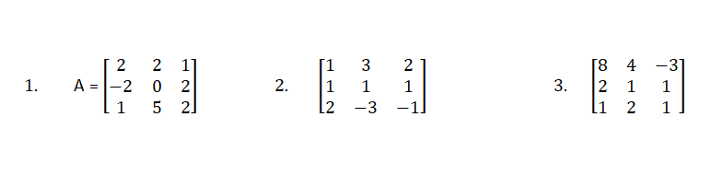
Find Inverse of a Matrix :
1 By Determinant Method
If A is non-singular square matrix, then
_{𝐴}−1 ₌
1
𝑎𝑑𝑗 𝐴
det(𝐴)

Slide 41
Inverse of a matrix 2. By Elementary Transformation :
Gauss-Jordan Method :
Let A be a given non-singular matrix of order n. Let 𝐼_{𝑛} be the unit matrix of order n.
To find 𝐴⁻¹, take the matrix 𝐴 ∶ 𝐼_{𝑛} and reduce it with the help of a series of row operations to the form
𝐼_{𝑛} ∶ 𝐵 . Then 𝐵 = 𝐴⁻¹.

Slide 42
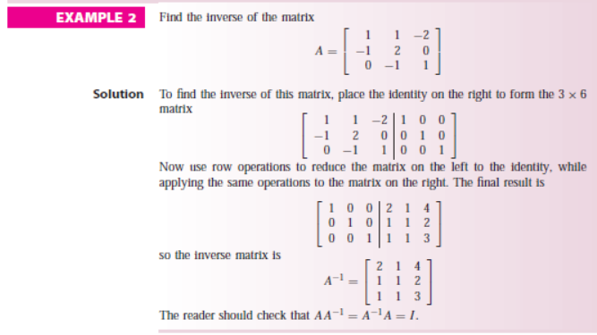

Slide 43
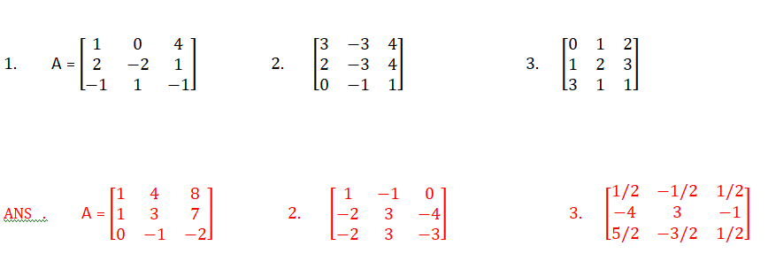
Find the Inverse of a matrix 2. By Elementary Transformation :
Gauss-Jordan Method :

Slide 44
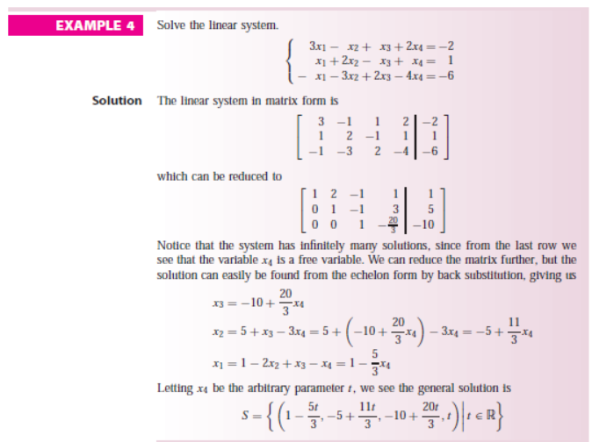

Slide 45
Inverses and Powers of Diagonal Matrices :
A general n× 𝑛 diagonal matrix D can be written as
D =
A diagonal matrix is invertible if and only if all of its diagonal
entries are non-zero.
In this case D is
_{𝐷}−1 ₌
𝑑₁ | 0 | ⋯ | 0
0 ⋮ | 𝑑₂ ⋮ | ⋯ | 0 ⋮
0 | 0 | ⋯ | 𝑑_{𝑛}
1 𝑑₁ | 0 | ⋯ | 0
0 ⋮ 0 | 1 𝑑₂ ⋮ 0 | ⋯ 0 | 0 ⋮ 1 𝑑_{𝑛}

Slide 46
_{𝑑1}𝐾
0
_{𝑑2}𝐾
⋮ 0
⋯ 0
⋯ 0
⋮
_{𝑑𝑛}𝐾
0
⋮ 0
𝐾
𝐷 =
0
i.e.
1 0 0
0 −3 0
0 0 2
IF A =
, then
1
0
0
0
₋₃
0
0
0
₂
1 0 0
0 −243 0
0 0 32
_{𝐴}−1 ₌
𝐴⁵ =

Slide 47
Rank of Matrix :
A matrix is said to be of rank r if it satisfies the following properties :
There is at least one minor of order r which is not zero
Every minor of order (r+1) is zero.
Rank of matrix A is denoted by 𝜌(𝐴).
There are three methods for finding the rank of a matrix
Rank of a matrix by Determinant method.
Rank of a matrix by row Echelon form.
Rank of a matrix by Normal form.

Slide 48
I. If A is zero matrix then 𝜌 𝐴 = 0.
◆ Note :
II. If A is not a zero matrix then 𝜌 𝐴 ≥ 1.
If A is a non-singular n× 𝑛 matrix then 𝜌 𝐴
𝜌 𝐼_{𝑛} = 𝑛 , where 𝐼_{𝑛} is 𝑛 × 𝑛 unit matrix .
V. If A is 𝑚 × 𝑛 matrix then 𝜌 𝐴 ≤ 𝑚𝑖𝑛 𝑚 , 𝑛 .
= 𝑛.

Slide 49
Rank of Matrix by Row Echelon Form :
The rank of a matrix in row echelon form is equal to the number of non-zero rows of the matrix.
i.e.
Rank of matrix = Number of non-zero rows
e.g.
1 2 5 0
0 0 1 0
0 0 0 0
𝐼𝑓
𝐴 =
𝑡ℎ𝑒𝑛
𝜌 𝐴
= 𝑁𝑢𝑚𝑏𝑒𝑟 𝑜𝑓 𝑛𝑜𝑛
𝜌 𝐴 = 2

Slide 50




EXAMPLE 2:
Rank By Minor Method
Find the rank of the matrix
⎛ ₁
2 1 −1⎞
5 2
1 0
⎜
A= ⎜9
2 ⎟
⎜ ₇
₄ ⎟
⎝
⎠

Slide 51

Solution:
The maximal minors have order 3, so we compute the 4 minors of order 3. The first one is
1 2 1
9 5 2 =7.( −1)+( −1).( − 7)=0
7 1 0
The other three are also zero. Since all minors of order 3 are zero, the rank must be rk(A) < 3.
¹ ² = 5 −18 = −13 ≠ 0
9 5
We continue to look at the minors of order two. The first one is
It is not necessary to compute any more minors, and we conclude that rk(A) = 2. In fact, the rst two columns of A are linearly independent.

Slide 52



4. USING NORMAL FORM
NORMAL: A complex square matrix A is normal if
A*A=AA*
where A* is the conjugate transpose of A. That is, a matrix is normal if it commutes with its conjugate transpose.
A matrix A with real entries satisfies A*=A^{T}, and is therefore normal if A^{T}A = AA^{T}.

Slide 53
4. USING NORMAL FORM
NORMAL: A complex square matrix A is normal if
A*A=AA*
where A* is the conjugate transpose of A. That is, a matrix is normal if it commutes with its conjugate transpose.
A matrix A with real entries satisfies A*=A^{T}, and is therefore normal if A^{T}A = AA^{T}.

Slide 54

Find the rank of a matrix using normal form,
EXAMPLE:
⎛ 2 3 4 5 ⎞
⎜ 3 4 5
5 6
10 11
₆ ⎟
A= ⎜
⎟
7 ⎟
⎜ 4
⎜ ₉
12 ⎟
⎝ ⎠
Solution:
Reduce the matrix to echelon form,
⎛ 2 | 3 | 4 | 5 ⎞ | ⎛ 1 | 0 | 0 | 0 ⎞
⎜ ₃ ⎜ | 4 | 5 | ₆ ⎟ | ⎜ ₀ | 1 | 2 | ₃ ⎟ ⎟
⎟ − −− > ⎜
⎜ 4
5 6
10 11 12 ⎟
7 ⎟ ⎜ 0
0 0
0 0
0 ⎟
⎜ ₉
⎜ ₀
₀ ⎟
⎝
⎠
⎝
⎠

Slide 55


Now,convert the reduced matrix to normal form by using row/column operations,
⎛ 1 0 0 0 ⎞
1 2
0 0
0 0
⎛ 1 0 0 0 ⎞
1 0
0 0
0 0
⎜ ₀
₃ ⎟
⎜ ₀
₀ ⎟
⎜
⎜ 0
⎟ − −− > ⎜
⎟
0 ⎟
0 ⎟
⎜ 0
⎜ ₀
₀ ⎟
⎜ ₀
₀ ⎟
⎝
⎠
⎝
⎠
⎛ 1 0 0 0 ⎞
1 0
0 0
0 0
⎜ ₀
₀ ⎟
⎛ I2 0 ⎞
⎟
⎜
⎜ 0
⎟ _{= ⎜}
0 ⎟
⎝ 0 0 ⎠
⎜ ₀
₀ ⎟
⎝ ⎠
The given matrix is normal.
Now the rank will be defined by the suffix of the identity matrix ie 2.
∴rank(A)=2

Slide 56
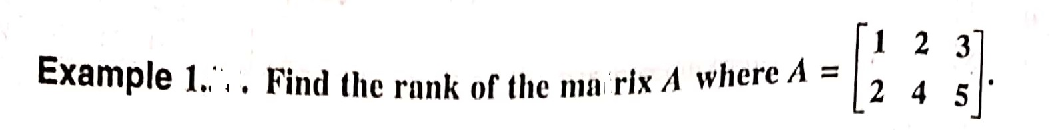
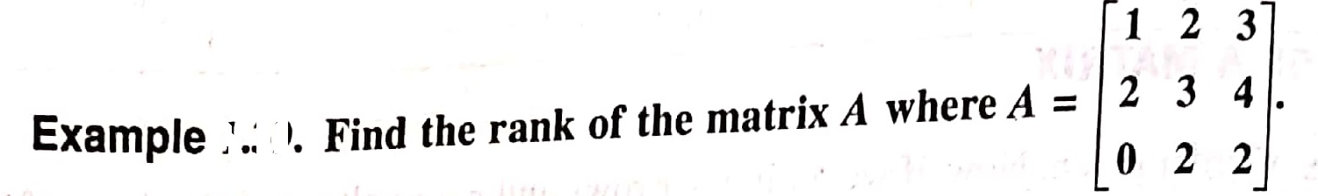
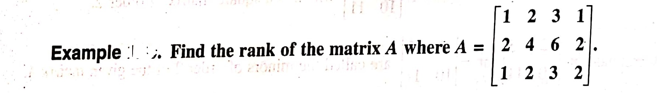

Slide 57
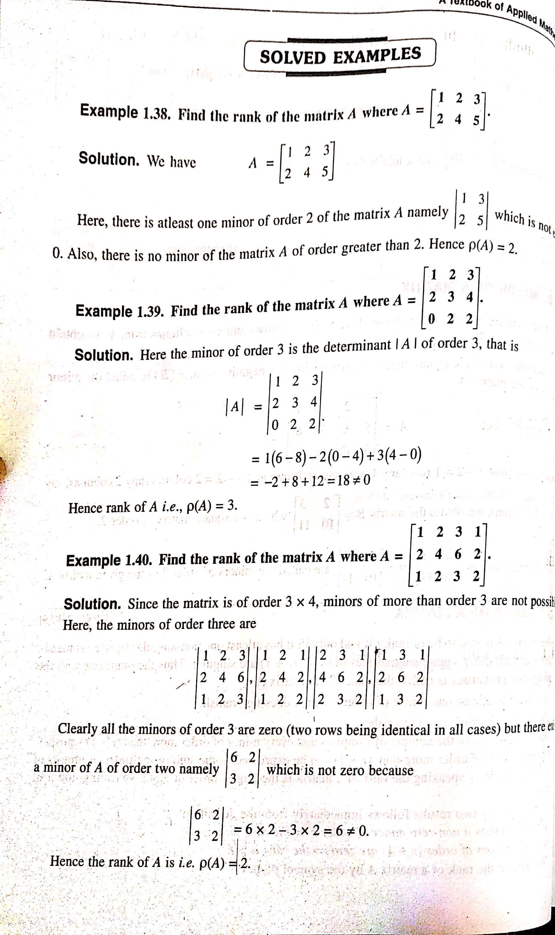

Slide 58
SOME SPECIAL MATRIX :
1. Symmetric Matrix :
A Square matrix A= 𝑎_{𝑖𝑗}
is called symmetric matrix
𝑛×𝑛
if ∀ 𝑖 & 𝑗. OR A = 𝐴^{𝑇} 1 4 5
4 −3 0
5 0 7
^{𝑎}𝑖𝑗 ^{= 𝑎}𝑗𝑖
7 −3
−3 5
i.e.

Slide 59
2. Skew Symmetric Matrix :
A Square matrix A= 𝑎_{𝑖𝑗}
𝑎_{𝑖𝑗} = −𝑎_{𝑗𝑖} ∀ 𝑖 & 𝑗.
is called Skew symmetric matrix if
𝑛×𝑛
OR A = −𝐴^{𝑇}
If 𝑖 = 𝑗 , 𝑎_{𝑖𝑖} = −𝑎_{𝑖𝑖} 2𝑎_{𝑖𝑖} = 0
𝑎_{𝑖𝑖} = 0 ∀ 𝑖
Thus the diagonal element of a skew symmetric matrix are all zero.
0 1 4
−1 0 −3
−4 3 0
0 ℎ 𝑔
−ℎ 0 𝑓
−𝑔 −𝑓 0
i.e.
3. Orthogonal Matrix :
A square matrix A is called orthogonal if
_{𝐴}𝑇 _{= 𝐴}−1
𝑜𝑟 𝐴𝐴^{𝑇} = 𝐴^{𝑇}𝐴 = 𝐼.

Slide 60
Complex Matrix :
If all the element of a matrix are real numbers then it is called a real matrix.
If at least one element of a matrix is a complex number 𝑎 + 𝑖𝑏
where 𝑎 , 𝑏 are real numbers and 𝑖 =
called a complex matrix.
i.e.
−1 then the matrix is
2 + 𝑖 | 0 | −5
3 | −𝑖 | 4 + 2𝑖

Slide 61
◆ Conjugate of a matrix :
The matrix obtained from any given matrix A by replacing its element by the corresponding complex conjugates is called the
conjugate of A and is denoted by 𝐴.
i.e.
2 + 3𝑖 −4𝑖
5 7 − 2𝑖
2 − 3𝑖
5
4𝑖
7 + 2𝑖
𝐴 =
⇒ 𝐴 =
◆ Transposed conjugate of a matrix :
The transpose of the conjugate matrix of a matrix A is called the transposed conjugate of A and is denoted by 𝐴∗
i.e.
𝑇
𝐴∗ = 𝐴 =
_{𝐴}𝑇

Slide 62
Hermitian Matrix :
A square matrix 𝐴 = is said to be Hermitian if Or
^{𝑎}𝑖𝑗
^{𝑎}𝑖𝑗 ^{= 𝑎}𝑖𝑗
∀ 𝑖 & 𝑗
𝐴 = 𝐴∗
i.e.
𝑇
where 𝐴∗ = 𝐴
1 2 − 3𝑖 4 + 𝑖
2 + 3𝑖 3 1 + 2𝑖
4 − 𝑖 1 − 2𝑖 7
Note : In a Hermitian matrix, the diagonal elements are real

Slide 63
Skew Hermitian Matrix :
A square matrix 𝐴 =
𝑎_{𝑖𝑗} = −𝑎_{𝑖𝑗}
is said to be skew Hermitian matrix if
^{𝑎}𝑖𝑗
∀ 𝑖 & 𝑗
Or
𝑇
𝐴 = 𝐴∗
where 𝐴∗ = 𝐴
2𝑖 3 + 𝑖 5
−3 + 𝑖 0 −1 − 𝑖
−5 1 − 𝑖 −𝑖
i.e.
Note : In a skew Hermitian matrix , the diagonal elements are zero or purely imaginary numbers.

Slide 64
◆ Unitary Matrix : A square matrix A is said to be unitary if
_{𝐴}∗ _{= 𝐴}−1
or 𝐴∗𝐴 = 𝐴𝐴∗ = 𝐼
𝑇
𝐴
Where 𝐴∗ =

Slide 65
LU FACTORIZATION
METHOD
OR
LDU Factorization

Slide 66
LU Factorization Method :
This method is based on the fact that every square matrix can be represented as a product of lower and upper triangular matrix; i.e. [A]=[L]*[U]
[L]=Lower triangular matrix; [U]=Upper triangular matrix
Provided all the principle minors are non singular .
Let us consider we have :
𝑎₁₁𝑥 + 𝑎₁₂𝑦 + 𝑎₁₃𝑧 = 𝑏₁
𝑎₂₁𝑥 + 𝑎₂₂𝑦 + 𝑎₂₃𝑧 = 𝑏₂
𝑎₃₁𝑥 + 𝑎₃₂𝑦 + 𝑎₃₃𝑧 = 𝑏₃
the system of equation can be represented as : [A]*[X]=[B] now matrix A can be represented as [A]=[L]*[U]

Slide 67
[A]=[L]*[U]
L11
L21
L31
0 0
𝑙₂₂ 0
^{𝑙}32 ^{𝑙}33
^{1 𝑢}12 ^{𝑢}13
* 0 1 𝑢₂₃
0 0 1
From here we have to find the values of the elements of lower & upper triangular matrix.
Then : [A]*[X]=[B];
[L]*[U]*[X]=[B]; As : [A]=[L]*[U]
Now we have to consider that [U]*[X]=[Y] ----------(i)
So that [L]*[Y]=[B]---------------------(ii)
Now using the (ii) equ. We have to find the elements of matrix [Y];where [L],[B] Is known to us.
Then using the matrix [Y] in equ. (i) we can find the unknown variable matrix
[X] & get the set of solution of the given equation.

Slide 68
For example we have three equation given bellow and find the sol by LU method :
8𝑥 − 3𝑦 + 2𝑧 = 20
4𝑥 + 11𝑦 − 𝑧 = 33
6x + 3𝑦 + 12𝑧 = 36
The given equ can be represented as : [A]*[X]=[B];
 | 8 | −3 | 2 |  | 20 |  | 𝑥
A= | 4 | 11 | −1 | ,B= | 33 | ,X= | 𝑦
 | 6 | 3 | 12 |  | 36 |  | 𝑧
◆ A=L*U;
^{𝑙}11
^{ 𝑙}21
^{𝑙}31
0 0
𝑙₂₂ 0 *
^{𝑙}32 ^{𝑙}33
^{1 𝑢}12 ^{𝑢}13
0 1 𝑢₂₃ =
0 0 1
8 −3 2
4 11 −1
6 3 12
Leading to : 𝑙 = 8 ;
3
^{𝑙}11^{𝑢}12
= −3 𝑢₁₂ = −( )
11
8

Slide 69
𝑙₁₁𝑢₁₃ = 2 𝑢₁₃ =
1
4
;
𝑙₂₁ = 4; 𝑙₂₁𝑢₁₂ + 𝑙₂₂ = 11
25
𝑙₂₁ = 11 − 𝑙₂₁𝑢₁₂ = ( ₂ )
+ 𝑙₂₂𝑢₂₃ = −1 𝑢₂₃ =
₋ 4
^{𝑙}21^{𝑢}13
5
𝑙₃₁ = 6; 𝑙₃₁𝑢₁₂ + 𝑙₃₂ = 3
𝑙₃₁𝑢₁₃ + 𝑙₂₂𝑢₂₃ + 𝑙₃₃ = 12
6 ∗ −
3
+ 𝑙₃₂ = 3
21
𝑙₃₂ = ( ₄ )
8
𝑙
₌ ₍567
) [using the values ]
33
50
8 0 0
4 ( ) 0
2
3
1
1 −( ) ( )
8 4
0 1 (− ⁴ )
0 0
25
Hence [L]=
& [U]=
21
567
25
1
6 ( ) ( )
4 30
Thus the equation A*X=B i.e. L*U*X=B
Now consider L*Y=B ------------(I)
where U*X=Y-------------(II)

Slide 70
0
4 ( ) 0
2
8 0
𝑌
25
1
20
=33
36
❑
*
𝑌₂
𝑌₃
21
567
6 ( )
( )
4 30
So that : 8𝑌₁ = 20
5
𝑌₁ = ( )
2
4𝑌₁ +
25
2
∗ 𝑌₂ = 33
𝑌₂ =
33 − 4 ∗
5
2
∗
2
25
46
= ( )
25
6𝑌₁ +
21 567
4 50
567
23
𝑌₂ + 𝑌₃ = 36 𝑌₃ =
∗ 36 − 15 − 21 ∗
50
= 1
50
Now putting the values on equ. (ii) we get :
3 1
5
1 −( ) ( )
8 4
0 1 (− ⁴ ) *
0 0
𝑥
𝑦
𝑧
( )
2
❑
=
46
( )
25
1
25
1
which gives
z= 1,
𝑦 −
4 46
25
46
4
𝑧 = ( )
y = ( ) +
)=2
25
25
25

Slide 71
𝑥 −
3
8
𝑦 +
𝑧 4
5
5
6
8
1
4
= ( )
x = ( +
−
)=3
2
2
❑
Hence the set of solution is given as :
𝑥 = 3 ; 𝑦 = 2 ; 𝑧 = 1 .

Slide 72
Solve the system of linear Equation by the LU Method 2x+y+z+w= 1; 4X+Y+W=-2 ; -2X+2Y+Z+W=7 Solve the system of linear Equation by the LU Method 10X+2Y+Z =9; 2X+20y-2Z=-44; -2X+3Y+10Z=22

Slide 73
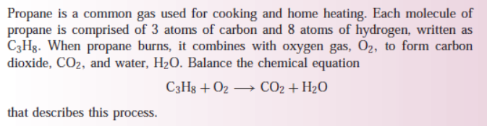
Application of System of linear equation and matrix
Activity 1. Balancing Chemical equation by solving a linear equations
Aim: To understand application Based on linear equation system
Objective: To understand the application of linear equation system.
Materials Required:
1. Paper A4 size
2. Pencil
3. Eraser
Example:
We convert these type equations in linear system of equation and solve them by using different type of method of linear equations.
Outcomes: Students learn convert chemical equations in linear equations and able to solve these by different methods.

Slide 74
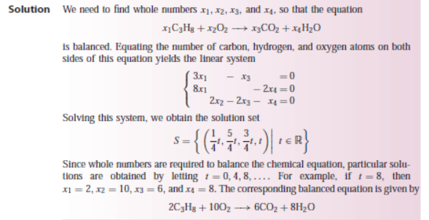

Slide 75
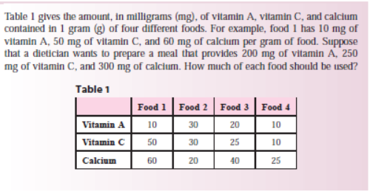

Slide 76
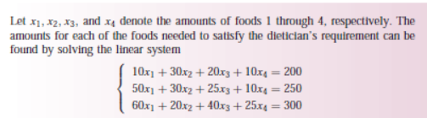

Slide 77
THANK YOU

